Slide 1
INTRODUCTION TO JAVASCRIPT – ES6

Slide 2
Companies using JavaScript
ALMOST EVERYONE

Slide 3
Where do they use it for?
BROWSERS
FRONTEND WEB DEVELOPMENT
SERVERS
NODE.JS RUNTIME
ENVIRONMENT
DESKTOPS
WINDOWS/ LINUX/ MAC OS - APPLICATIONS
MOBILE
ANDROID/ IOS

Slide 4
Why you need to Learn JavaScript
FULL STACK DEVELOPMENT

Slide 5
JavaScript Basics
DOM Manipulation
Objects in JavaScript

Slide 6
ES6 Basics
let, const
2. Array Helpers
3. Arrow Functions

Slide 7
INTRODUCTION TO NODE.JS

Slide 8
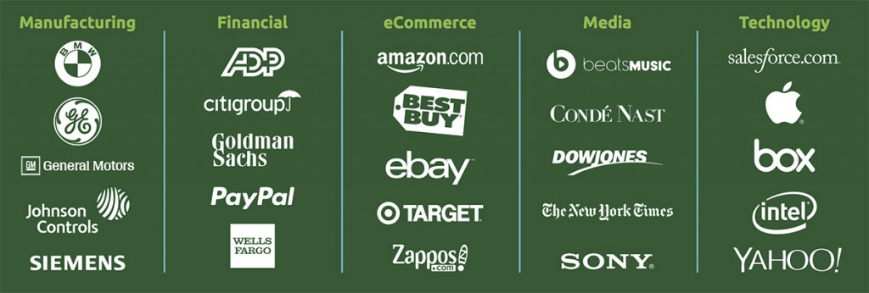
Companies using Node.JS

Slide 9
What is Node.JS
JAVASCRIPT
RUNTIME

Slide 10
Node.JS Basics
Run JS using Node.js
NPM
Node.js as a server - Express

Slide 11
INTRODUCTION TO
ELECTRON

Slide 12
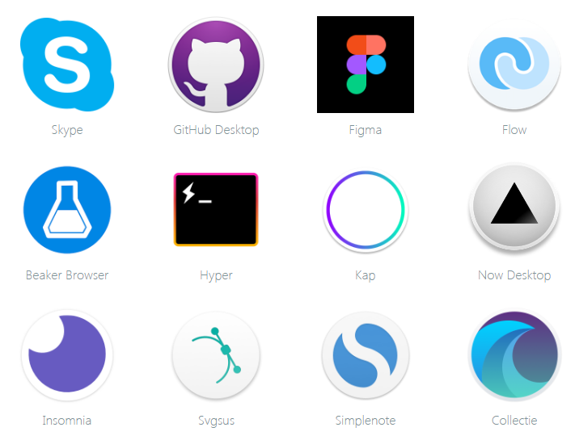
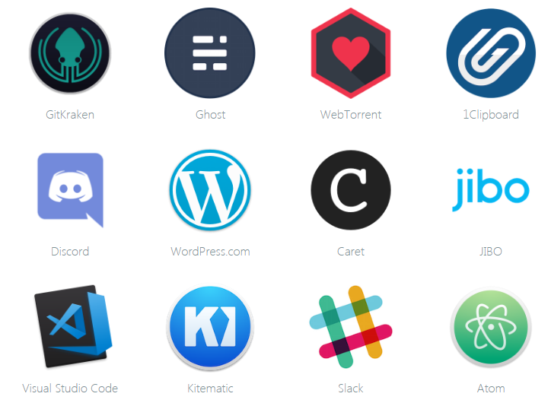
APPS BUILT ON ELECTRON

Slide 13
ELECTRON BASICS
Create Electron Application
https://github.com/electron/electron-quick-start.git
2. ipcRenderer, ipcMain

